Slide 1



Data Analysis of Retail Sales CSV File in Python
In this presentation, we will explore how to leverage the power of Python to analyze a retail sales CSV file. We'll cover the key steps involved, from importing the data to generating insightful visualizations. By the end, you'll understand the benefits of using data analysis to improve business performance and drive strategic decisions within your industry.
Submitted by - Submitted to :-
ADITYA RAJ Teja Ranganath
ID :- BCS2023014 DCS Mentor
Roll no :- 2310303018 Invertis University
B.Tech (CSE) (III SEM) Bareilly
Section :- C

Slide 2
Importing and Inspecting the CSV Data
Importing the CSV
Describing the Data
We'll start by using Python's built-in csv module to read in the retail sales CSV file. This will allow us to access the data and begin our analysis.
data = pd.read_csv("/content/retailsales.csv")
Next, we'll use Pandas to get a high-level overview of the data, including the column names, data types, and any missing values. This will help us understand the structure and quality of the dataset.
data.describe()
Getting head of the data
Getting tail of the data
The "head" of a CSV file refers to the first few rows, usually including column headers and some data rows.
data.head() returns the first 5 rows of the file. You can specify the number of rows as data.head(10) for the first 10 rows.
The data.tail() method fetches the last rows of the dataset. By default, it shows 5 rows, but you can pass integer argument to specify the count.

Slide 3
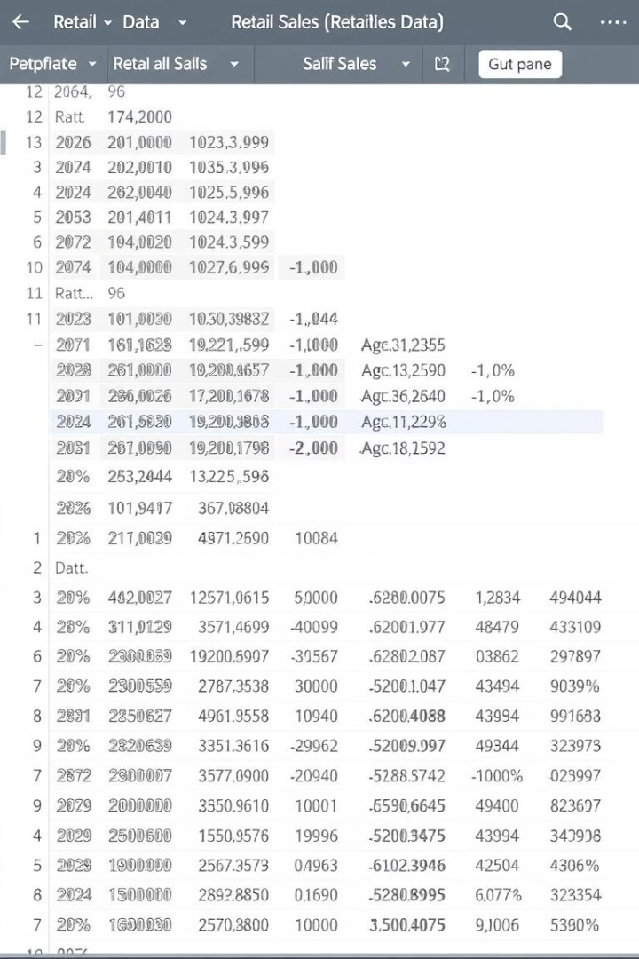
Exploring the Data
Inspecting Null Values
Identifying Duplicates
We'll check for any null or missing values in the data, which could impact our analysis. Handling these properly is crucial for maintaining data integrity.
Searching for and removing any duplicate rows in the data will help ensure we're working with a clean, accurate dataset.
Detecting Outliers
By identifying and addressing any outliers in the data, we can improve the reliability and accuracy of our analysis.

Slide 4

Benefits for the Retail Industry
1
Informed Decision Making
2
Improved Efficiency
3
Competitive Advantage
Data analysis provides retailers with valuable insights to make more informed, data-driven decisions about pricing, inventory management, and customer targeting.
By identifying and addressing problem areas, retailers can optimize their operations, reduce costs, and enhance overall efficiency.
Leveraging data analysis gives retailers a competitive edge by allowing them to better understand and respond to market trends and customer preferences.

Slide 5

Benefits for Business Analytics
Identify Trends and Patterns
Optimize Pricing and Promotions
Data analysis allows businesses to uncover hidden trends and patterns in their sales data, which can inform strategic planning and decision-making.
By analyzing historical sales data, businesses can develop more effective pricing and promotional strategies to boost revenue and profitability.
Enhance Customer Segmentation
Data analysis can help businesses better understand their customer base, enabling them to create more targeted marketing campaigns and improve customer loyalty.

Slide 6

Improving Business Performance
1
Identify Pain Points
By analyzing the data, we can pinpoint areas of the business that are underperforming, such as slow-moving inventory or inefficient marketing campaigns.
2
Optimize Operations
With the insights gained from data analysis, retailers can make data-driven decisions to streamline operations, reduce costs, and improve overall efficiency.
3
Enhance Customer Experience
Understanding customer behavior and preferences through data analysis enables retailers to deliver a more personalized and satisfying shopping experience, leading to increased loyalty and revenue.

Slide 7
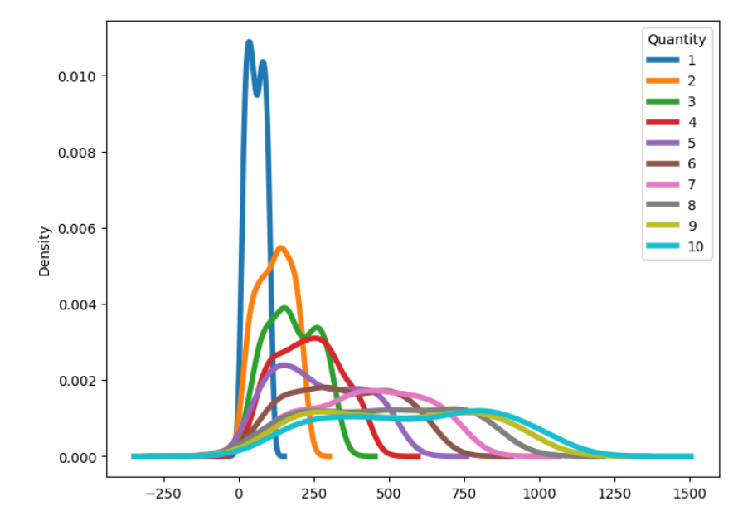
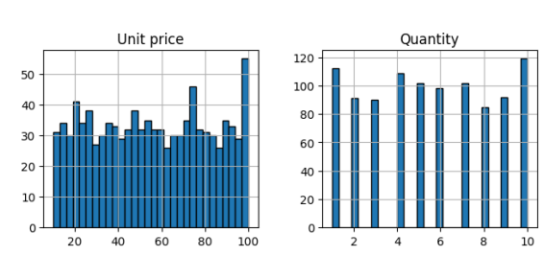
Univariate Analysis
Histogram
Density Plot
We'll start by generating a histogram to visualize the distribution of our sales data. This will help us identify any skewness, outliers, or multimodal patterns.
A density plot is another effective way to understand the underlying distribution of our data. This can provide additional in insights beyond what a histogram can reveal.

Slide 8
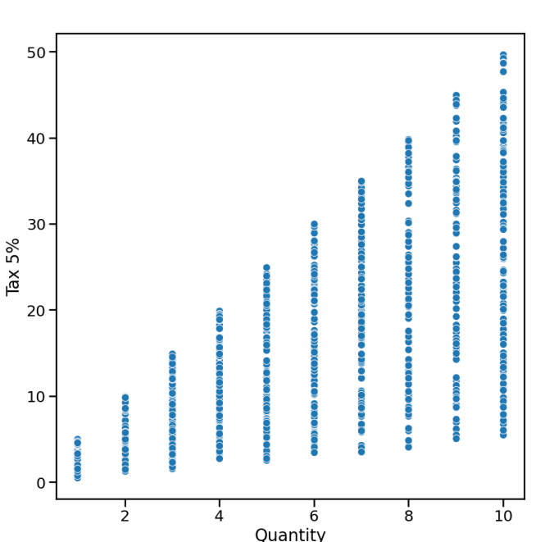
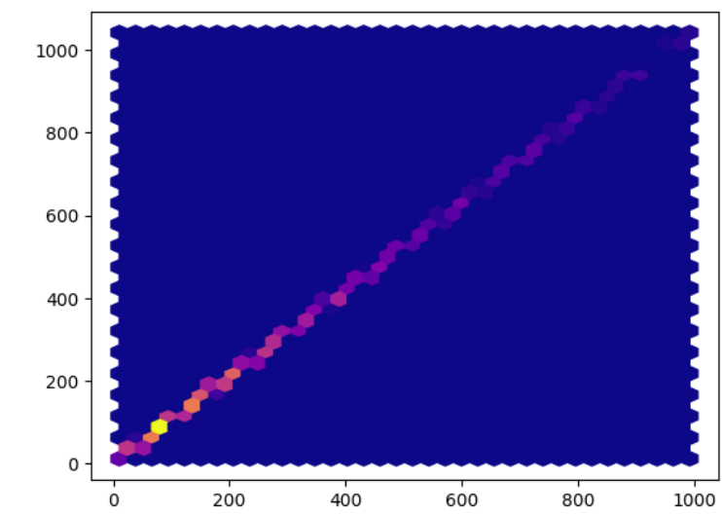
Bivariate Analysis
Hexbin plot
Scatterplot Matrix
Hexbin plot is a data visualization tool that represents the density of data points in a two-dimensional space using hexagonal bins. It is particularly useful for visualizing relationships in large datasets where scatter plots would result in overplotting and make the data patterns difficult to discern.
A scatterplot matrix allows us to explore the pairwise relationships between multiple variables, providing a comprehensive view of the data structure.

Slide 9
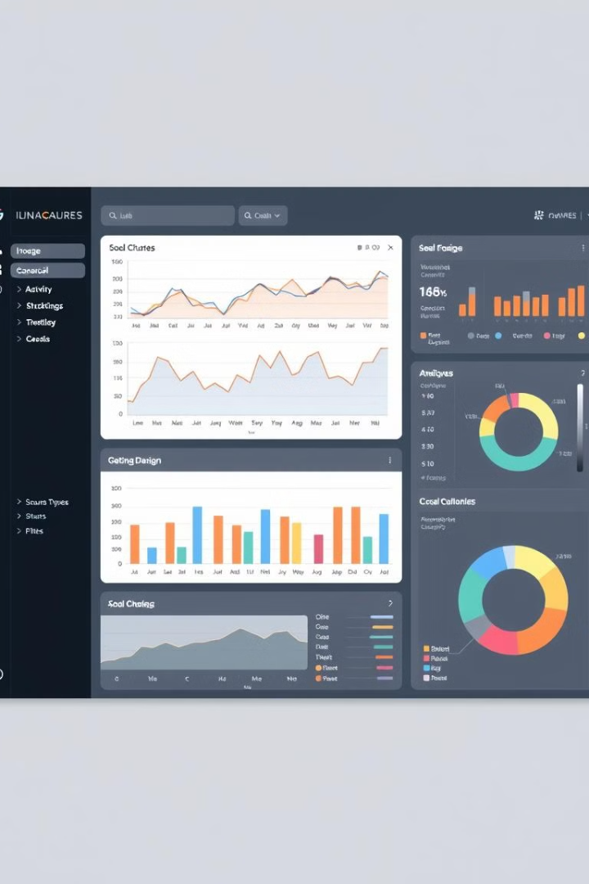



Visualizing the Data
Bar Charts
Bar charts are effective for comparing values across different categories, such as sales by product or region.
Line Graphs
Line graphs excel at showing trends over time, allowing us to identify seasonal patterns or long-term changes in the data.
Scatter Plots
Scatter plots help us visualize the relationship between two variables, revealing correlations and potential outliers.

Slide 10

Conclusion
In this presentation, we've explored how to leverage the power of Python and data analysis to unlock valuable insights from a retail sales CSV file. By importing the data, cleaning and exploring it, and generating insightful visualizations, we've demonstrated the benefits of data analysis for both the retail industry and business analytics. Armed with these tools and techniques, you can now use data to drive informed decision-making, optimize operations, and enhance the customer experience - ultimately boosting your organization's performance and competitiveness.

